Slide 1


SAP Full-Stack Developer training
ABAP on HANA, UI5 & Fiori, Analytics with OData
Anubhav Oberoy
Day – 13

Slide 2

Agenda – Day 13
What is AMDP
Introduction of AMDP
Implementation of AMDP
Why we use AMDP
Describing Rules for AMDP
Describing New way to Create Structure
Create AMDP for Consume SQL Script in ADT
--Break—
Introduction of CDS(Core Data & Service )
Concept of CDS View
Describing Standard CDS View
Understanding Concept of Code to Data Paradigm
Creating CDS Entities

Slide 3


What is AMDP
AMDP is a method inside an Normal ABAP Class. These methods are special methods which can contain the SQL Script code.
When we write code, ABAP can tell you the syntax error also (Syntax Check)
When we activate AMDP nothing happens in HANA, But when we call it then it creates a procedure in HANA
We can add SQL Script code inside a method in an ABAP
All the AMDP methods must be static
The same ABAP Class can also contain ABAP Code as well but we cant merge ABAP + SQLScript together
We can call one AMDP from another AMDP
Can an AMDP be debugged?
Can I also implement a FOR ALL ENTRIES like logic using AMDP
Can I pass Select-options to AMDP
Spider bites (Mutation)
Marker Interface –
IF_AMDP_MARKER_HDB
Normal ABAP Class?
SQL Script Code

Slide 4

How to Create AMDP
Add an interface to ABAP class – IF_AMDP_MARKER_HDB
All the AMDP methods has to have parameters passed by Value
We cannot have Returning/ Changing parameters
The method cannot have deep structures
Must also mention the tables which we are planning to use in SQLScript code with a USING keyword
Syntax → METHOD method_name BY DATABASE PROCEDURE FOR HDB LANGUAGE SQLSCRIPT OPTIONS READ-ONLY USING tab1 tab2…
When we call AMDP then it will be created inside HANA
Lifecycle challenges is sorted fully.
Disadvantage:
Client handling
If we plan to use AMDP for DML scenario,
The LUW needs to be managed by developer.
If my co. is not on HANA DB we cannot implement AMDP.

Slide 5
ABAP Managed Data Procedure
Methods of global classes marked with tag interface, available since ABAP 7.4 SP05
AMDP classes and AMDP methods
Easy to consume in ABAP – as simple method call
AMDP methods are fully managed on the ABAP server
Source code editing with ABAP Editor (in ADT)
Static syntax check and syntax coloring for SQLScript code
Procedure created on first AMDP call
Detailed analysis of runtime errors in ST22
Transport analog to regular ABAP classes
ABAP Managed Database Procedures
“Top-Down”
Lifecycle
lr_customer->classify( EXPORTING in_date = in_date in_sel = in_sel IMPORTING out_itms = out_itms ).
ABAP Managed DB Procedure
Standard ABAP Transport
AS ABAP
deploy
Stored Procedure
SAP HANA

Slide 6
Integration of Database Procedures into ABAP
Standard ABAP class methods are used as containers for the implementation of AMDPs
Standard ABAP class methods are used as containers for the implementation of AMDPs
Standard ABAP class methods are used as containers for the implementation of AMDPs
CLASS CL_AMDP_SAMPLE DEFINITION.
PUBLIC SECTION.
INTERFACES IF_AMDP_MARKER_HDB. ...
PRIVATE SECTION.
METHODS execute IMPORTING VALUE(it_param) TYPE type1 EXPORTING VALUE(et_param) TYPE type2. ENDCLASS.
CLASS CL_AMDP_SAMPLE IMPLEMENTATION. ...
METHOD execute BY DATABASE PROCEDURE …. -- SQLScript code ENDMETHOD.
ENDCLASS.
Method container for an AMDP

Slide 7
AMDP Method – SQL Script
METHOD classify_by_id BY DATABASE PROCEDURE FOR HDB LANGUAGE SQLSCRIPT OPTIONS READ-ONLY USING SCUSTOM SBOOK.
-- declare local scalar variables declare lc_upper_threshold constant int := 300;
declare lc_lower_threshold constant int := 10; -- translate list of customer ids into id, name ,#of flights … lt_customers = select c.id, c.name, count( s.bookid ) … from scustom … where mandt = :iv_client and c.id in ( select id from :it_customer_id ) group by c.id, c.name;
-- calculate return table et_classification = select id, name,
case when flight_count > :lc_upper_threshold then 1 …
from :lt_customers …
ENDMETHOD.

Slide 8

Exercise
AMDP Code

Slide 9

Break

Slide 10
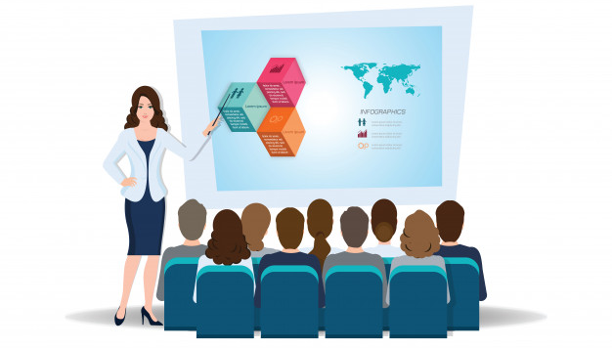
Introduction to Core Data & Services
CDS stands for Core Data Services. This is the new programming paradigm within new SAP environment specifically S/4HANA systems. So CDS views are the new programming design concepts which can achieve Code-to-Data paradigm which actually means Code push down into the database for processing.

Slide 11
Core Data & Services at Glance
1
4
Semantically Rich Data-Models
Domain specific languages (DDL, QL, DCL)
Declarative, close to conceptual thinking
Common Basis for Domain-Specific Frameworks e.g. UI, Analytics, OData, BW,…
@AnalyticsDetails.aggregationBehaviour: SUM
2
5
CDS is completely based on SQL
Any ‘Standard SQL’ features directly available like joins, unions, build-in functions, …
Built-in Functions and Code Pushdown
Table Functions for Breakout Scenarios
Rich Set of Built-in SQL Functions
3
6
Fully Compatible with Any DB
Generated and managed SQL Views
Modern Open SQL
Extensible
On model level thru extensions
On meta-model level thru annotations

Slide 12

Concept of CDS
Can I develop CDS views if my Company is not on HANA?
Yes, Provided your ABAP system is above NW 7.4 SP6 +.
You may not get the full potential as you may get when you are on HANA.
Are CDS views same as HANA Calculation Views?
No. HANA Calc view created in HANA Directly, But CDS views are created in ABAP.
When you activate it generate Runtime object which is a HANA View inside of HANA.
Which system do I code cds views.
ABAP system only using ADT
Which is the best way and best practice to implement the CDS views? Are there some guidelines on CDS views for S/4HANA?
You can get good performance with CDS views, there are guidelines which we can use like VDM
I have heard about HANA CDS views also, are these same?
No. ABAP CDS and HANA CDS are one concept but 2 flavor.
HANA CDS is used in companies who buys HANA only, they don’t have ABAP system. https://www.youtube.com/watch?v=rTsAg_OGh-A
Notes:
The sole purpose of an R/3 system is to provide a suite of tightly integrated, large-scale business applications. R/3 comes prepackaged with the core business applications needed by most large corporations. These applications coexist in one homogenous environment. They are designed from the ground up to run using a single database and one (very large) set of tables.
Presentation: It is usually installed on a user's workstation. When started, the presentation server displays the R/3 menus within a window. This window is commonly known as the SAPGUI, or the user interface (or simply, the interface).
Basis : Basis is like an operating system for R/3. It sits between the ABAP/4 code and the computer's operating system. SAP likes to call it middleware because it sits in the middle, between ABAP/4 and the operating system. ABAP/4 cannot run directly on an operating system. It requires a set of programs (collectively called Basis) to load, interpret, and buffer its input and output. Basis provides the runtime environment for ABAP/4 programs.
Database: The database server is a set of executables that accept database requests from the application server. These requests are passed on to the RDBMS (Relation Database Management System). The RDBMS sends the data back to the database server, which then passes the information back to the application server. The application server in turn passes that information to your ABAP/4 program.

Slide 13
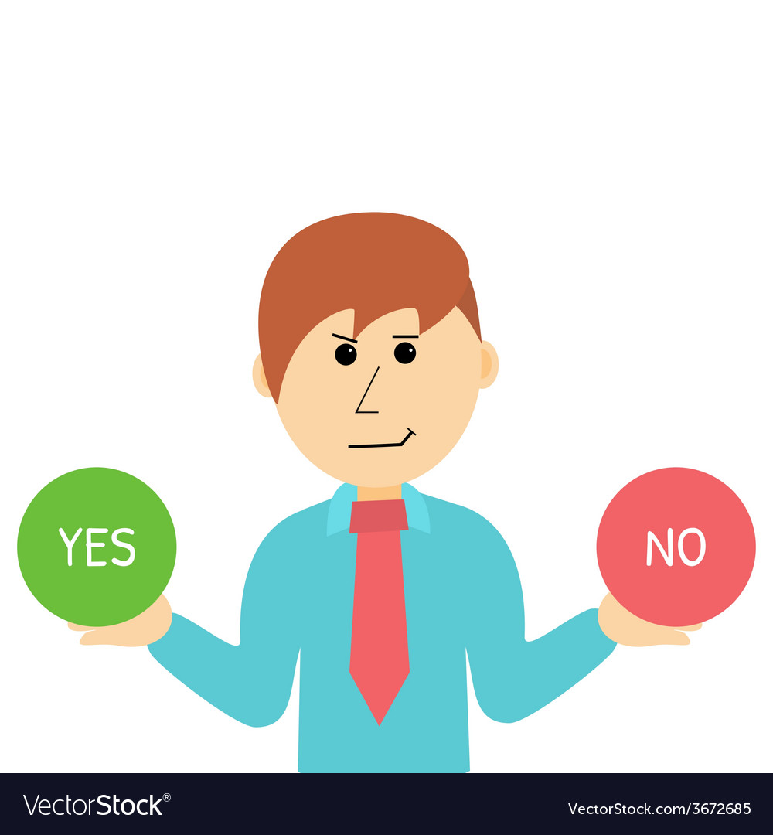
Concept of CDS
If I am not from ABAP Background, do I need to learn ABAP to code CDS Views?
From here, CDS is completely new syntax.
Can I also create new DB Table using CDS, or is it only for Views?
Yes, indeed if you learn ABAP on Cloud, perhaps this is the only way to create table in ABAP on Cloud System.
Can we update data also from CDS views or is it only View data.
No. But when this concept is combined with frameworks like BOPF and RAP. Here CDS will work like template/data structure/BO to tell the framework what kind of data to work.
Can Fiori App Call CDS view directly
No. FIORI ONLY AND ONLY TALKS TO ODATA
Can BO Reporting tool consume CDS views?
Yes, even SAP Analytics Cloud.
What is VDM, we hear this term a lot?
Virtual Data Modeling, This is a gold standard to build views in SAP S/4HANA.
Notes:
The sole purpose of an R/3 system is to provide a suite of tightly integrated, large-scale business applications. R/3 comes prepackaged with the core business applications needed by most large corporations. These applications coexist in one homogenous environment. They are designed from the ground up to run using a single database and one (very large) set of tables.
Presentation: It is usually installed on a user's workstation. When started, the presentation server displays the R/3 menus within a window. This window is commonly known as the SAPGUI, or the user interface (or simply, the interface).
Basis : Basis is like an operating system for R/3. It sits between the ABAP/4 code and the computer's operating system. SAP likes to call it middleware because it sits in the middle, between ABAP/4 and the operating system. ABAP/4 cannot run directly on an operating system. It requires a set of programs (collectively called Basis) to load, interpret, and buffer its input and output. Basis provides the runtime environment for ABAP/4 programs.
Database: The database server is a set of executables that accept database requests from the application server. These requests are passed on to the RDBMS (Relation Database Management System). The RDBMS sends the data back to the database server, which then passes the information back to the application server. The application server in turn passes that information to your ABAP/4 program.

Slide 14

Concept of CDS
Can we pass parameters to CDS, is there any way I can pass SELECT-OPTIONS also
We can pass parameter, we cant code SELECT-OPTION directly.
Can I call SQL Script code in CDS, Or can I call AMDP in CDS..
Yes, we have starring NW 7.5 a new option which called CDS table function.
How do we secure Data using CDS views
CDS DCL concept.
Can I extend a SAP Delivered CDS view?
Yes, we have CDS Extension concept.
Where can I find the list of All the SAP Delivered CDS views in S/4HANA.
https://api.sap.com/themes/CDSViews
I hear a term called CDS Entity, SAP says that this will overwrite CDS views. Is it true?
Yes.
Notes:
The sole purpose of an R/3 system is to provide a suite of tightly integrated, large-scale business applications. R/3 comes prepackaged with the core business applications needed by most large corporations. These applications coexist in one homogenous environment. They are designed from the ground up to run using a single database and one (very large) set of tables.
Presentation: It is usually installed on a user's workstation. When started, the presentation server displays the R/3 menus within a window. This window is commonly known as the SAPGUI, or the user interface (or simply, the interface).
Basis : Basis is like an operating system for R/3. It sits between the ABAP/4 code and the computer's operating system. SAP likes to call it middleware because it sits in the middle, between ABAP/4 and the operating system. ABAP/4 cannot run directly on an operating system. It requires a set of programs (collectively called Basis) to load, interpret, and buffer its input and output. Basis provides the runtime environment for ABAP/4 programs.
Database: The database server is a set of executables that accept database requests from the application server. These requests are passed on to the RDBMS (Relation Database Management System). The RDBMS sends the data back to the database server, which then passes the information back to the application server. The application server in turn passes that information to your ABAP/4 program.

Slide 15

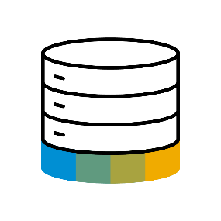
Paradigm Changes in Application Programming
Data-to-Code Intensive computations in APPLICATION layer
Application Programming Models
Classic Approach
Data Centric Approach
Database
Code-to-Data Intensive computations in DATABASE layer

Slide 16
A Family of Domain Specific Language
functions
functions
DDL
DCL
Data modelling and retrieval on a higher semantic level
Extends native SQL leads to higher productivity
Define authorizations for DDL views
Modelled and declarative approach
Integrates with classic authorization concepts
Data Definition Language
Query Language
Data Control Language
functions
QL
Consume CDS entities via Open SQL in ABAP
Fully transparent SQL extensions

Slide 17
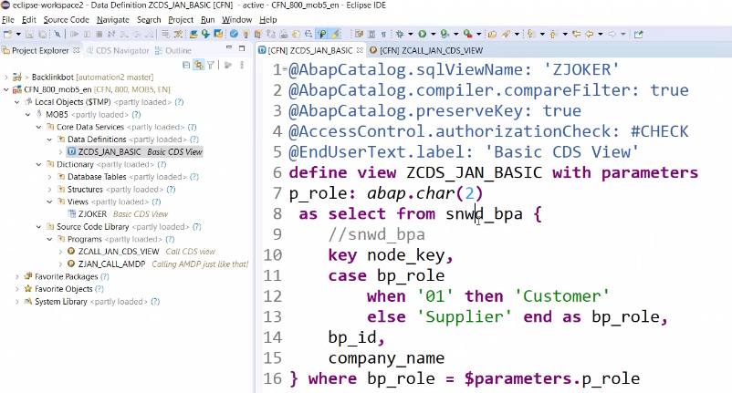
Creating CDS View

Slide 18
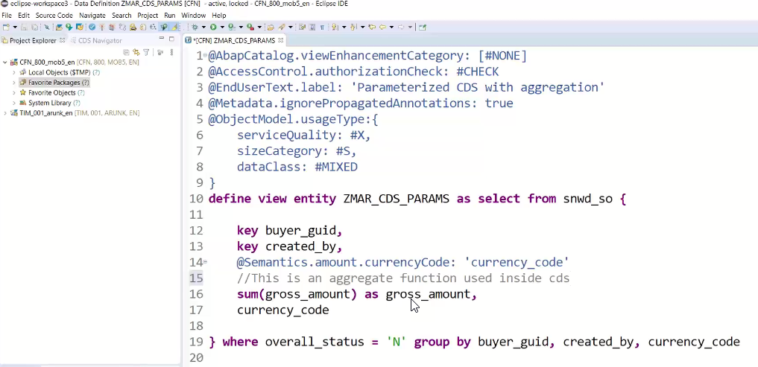
Core Data & Service Entities
A CDS entity has a specified number of columns, defined at the time of entity creation, but can have any number of rows. Database entities also typically have meta-data associated with them; the meta-data might include constraints on the entity or on the values within particular columns. SAP HANA Extended Application Services (SAP HANA XS) enables you to create a database entity as a design-time file in the repository. All repository files including your entity definition can be transported to other SAP HANA systems, for example, in a delivery unit. You can define the entity using CDS-compliant DDL.

Slide 19

Exercise
Basics of CDS View & CDS Entities Code

Slide 20

End of Day 13

Slide 21

Questions

Slide 22

Anubhav Oberoy

Slide 23


We’re committed to empower you to be
Most Desirable Resource
through powerful training solutions.
We build the workforce of the future.
250+
Corporate Clients
30,000+
Learners Trained
25000+
Learners Placed
FREE WEBINARS
Sign up for free webinars with industry experts every fortnight!
Enroll Now!
Contact us today!
https://anubhavtrainings.com/

Slide 24




More from AnubhavTrainings.com

